Slide 1
Serial number recognition

Slide 2
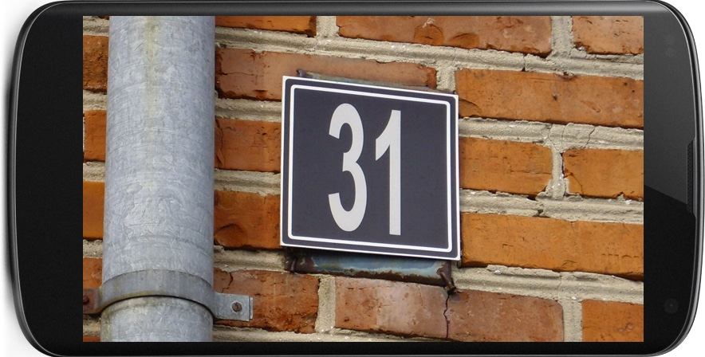
objective
31

Slide 3
Set up and data
Python
NumPy, SciPy, iPython
TensorFlow
OpenCV / SimpleCV
Keras, Skylearn
Street View House Numbers (SVHN): Dataset of house numbers in google view

Slide 4
Step 1:
Design and test a model architecture that can identify sequences of digits in an image.
Convolutional or Deep Neural Network
Sharing the weights between Softmax classifiers
Extract data from MNIST and notMNIST

Slide 5
Step 2:
Train model on real dataset
Using the SVHN dataset
Hyper parameters including fonts colors

Slide 6
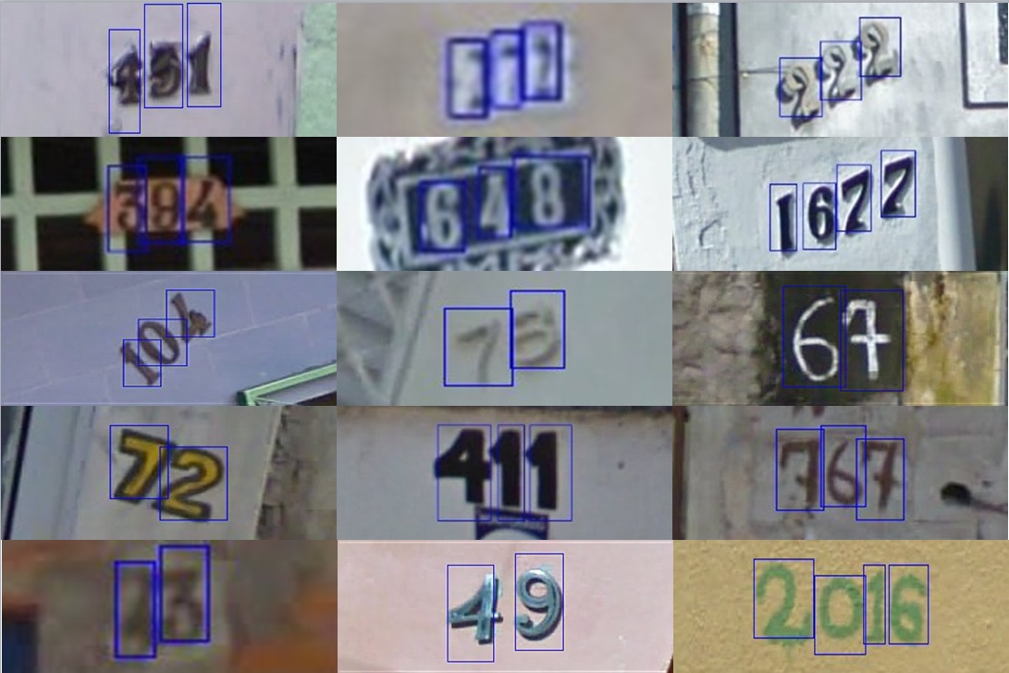
Feature of SVHN
SVHN dataset provides bounding boxes
Easy to track and tune for a localizer
Do not need to look at the edges

Slide 7
Resource
Course
Stanford CS231
Papers
Netzer, Y., et al. Reading Digits in Natural Images with Unsupervised Feature Learning. NIPS Workshop on Deep Learning and Unsupervised Feature Learning, 2011.
Goodfellow, I., et al. Multi-digit Number Recognition from Street View Imagery using Deep Convolutional Neural Networks. ICLR, 2014.

